Slide 1
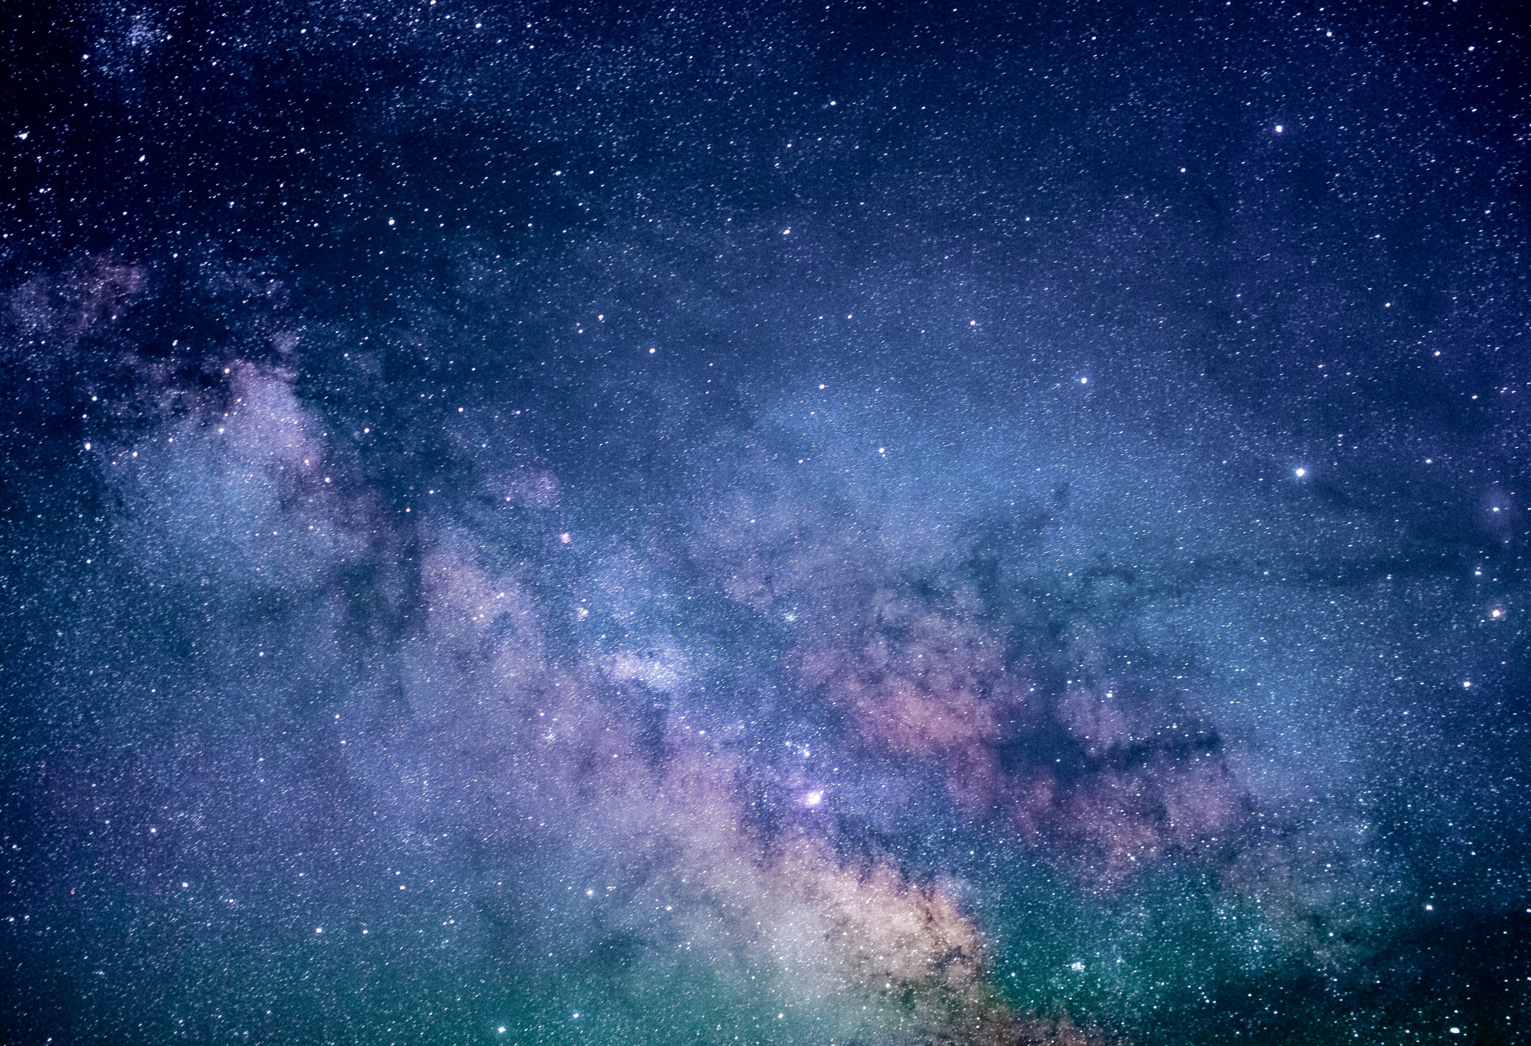
Stars And Solar System
By Group-2

Slide 2
The Stars
There are a number of stars in the galaxy is huge. If you observe carefully on a dark night and from a place away from a big city, all the stars are not of the same colour and brightness. Each star emits light of its own. The Sun is also a star, but why does it appear so large compared to the other stars?
Because the Sun is only 150,000,000 kilometres (150 million km) away from Earth. Whereas the next nearest start, Proxima Centuries, is about 40,000,000,000,000 kilometres (40 trillion km) from the Earth. Such large distances are expressed in another unity known as light years. It is the distance travelled by light in one year, which is about 9 trillion kilometres. Remember that the speed of light is about 300,000 kilometres per second.
Now here you might have a question which is, "If light from stars takes years to reach us, are we looking into the past when we look at stars?". The answer is yes, we are looking into the past when we look at stars.

Slide 3
The stars are also present in the sky during the day-time also. However, they are not visible then because of the bright sunlight.
Stars appear to move from east to west. A stars which rises in the east in the evening, seats in the west in the early morning. Now you might ask, "Why do stars appear to move from east to west?". Well when we look at the trees and bulidings outside while traveling they appear to be moving in the backward direction, which means of the stars appear to move from east to west then the Earth should rotate from west to east. And yes the Earth rotates from west to east, this also the reason why the Sun rises in the east and sets in the west. There is a star situated in the direction of the Earth's axis called pole star. It does not appear to move.

Slide 4
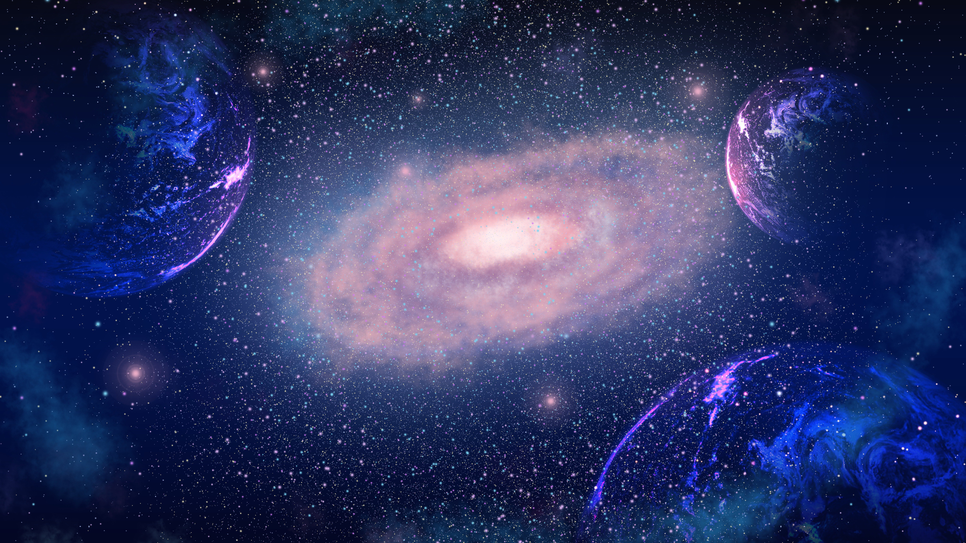
Activity 17.4
Stand in the centre of a big room and start rotating. In which direction will the objects in the room appear to move? Do you see them moving in the direction opposite to your motion

Slide 5
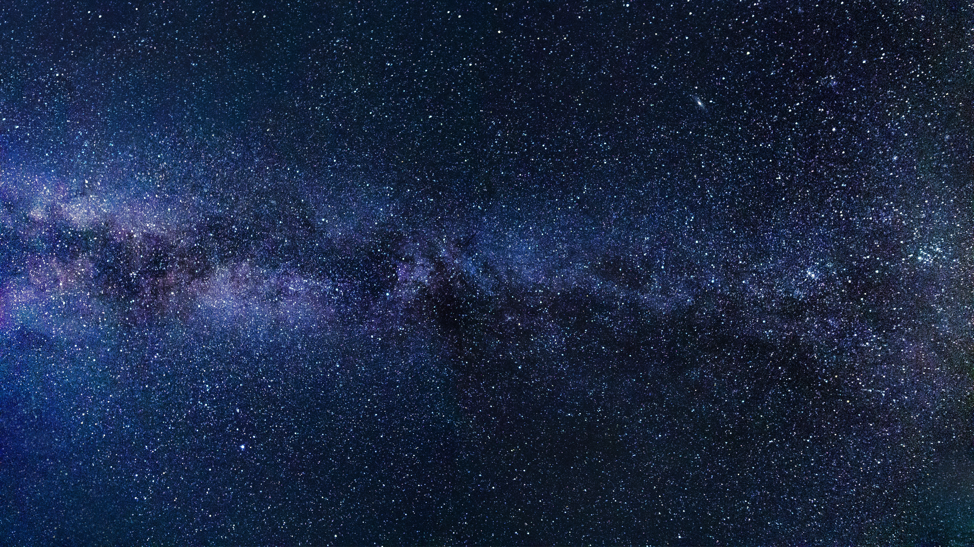

Activity 17.5
Take an umbrella and open it. Make about 10-15 stars out of white paper. Paste on star at the position of the central rod of the umbrella and others at different places on the cloth near the end of each spoke (as shown in figure). Now rotate the umbrella by holding its central rod in your hand. Observe the stars on the umbrella. Is there any star which does not appear to move? Where is this star located?
If there were a star located where the axis of rotation of the Earth meets the sky, could this star be stationary?

Slide 6
Constellations
The stars forming a group that has a recognisable shape is called a constellation. Constellations were devised by ancient people to be able to recognise stars in the sky. The shapes of constellations resemble objects familiar to those people. You can easily identify some constellations in the night sky. For this, you should know what a particular constellation looks like and where to look for it in the sky. So now we will learn about constellations.

Slide 7
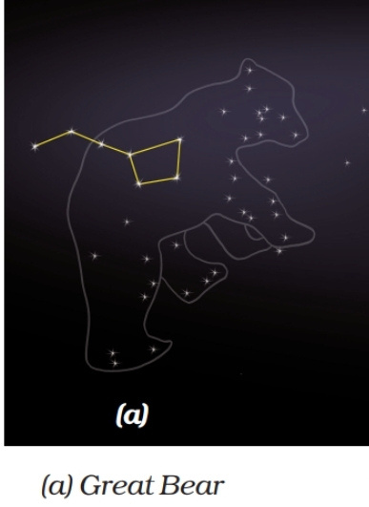
Ursa Major
One of the most famous constellations which you can see during summer time in the early part of the night is Ursa MajorIt is also known as the Big Dipper, the Great Bear or the Saptarshi. There are seven prominent stars in this constellation. It appears like a big ladle or a question mark. There are three stars in the handle of the ladle and four in its bowl. Saptarshi has been associated with seven who known ancient Indian sages, or rishis, as shown in the figure below. According to ancient mythology, the seven sages who form the Saptarshi, preserve the eternal knowledge of Vedas and explain it to people in every new age.

Slide 8
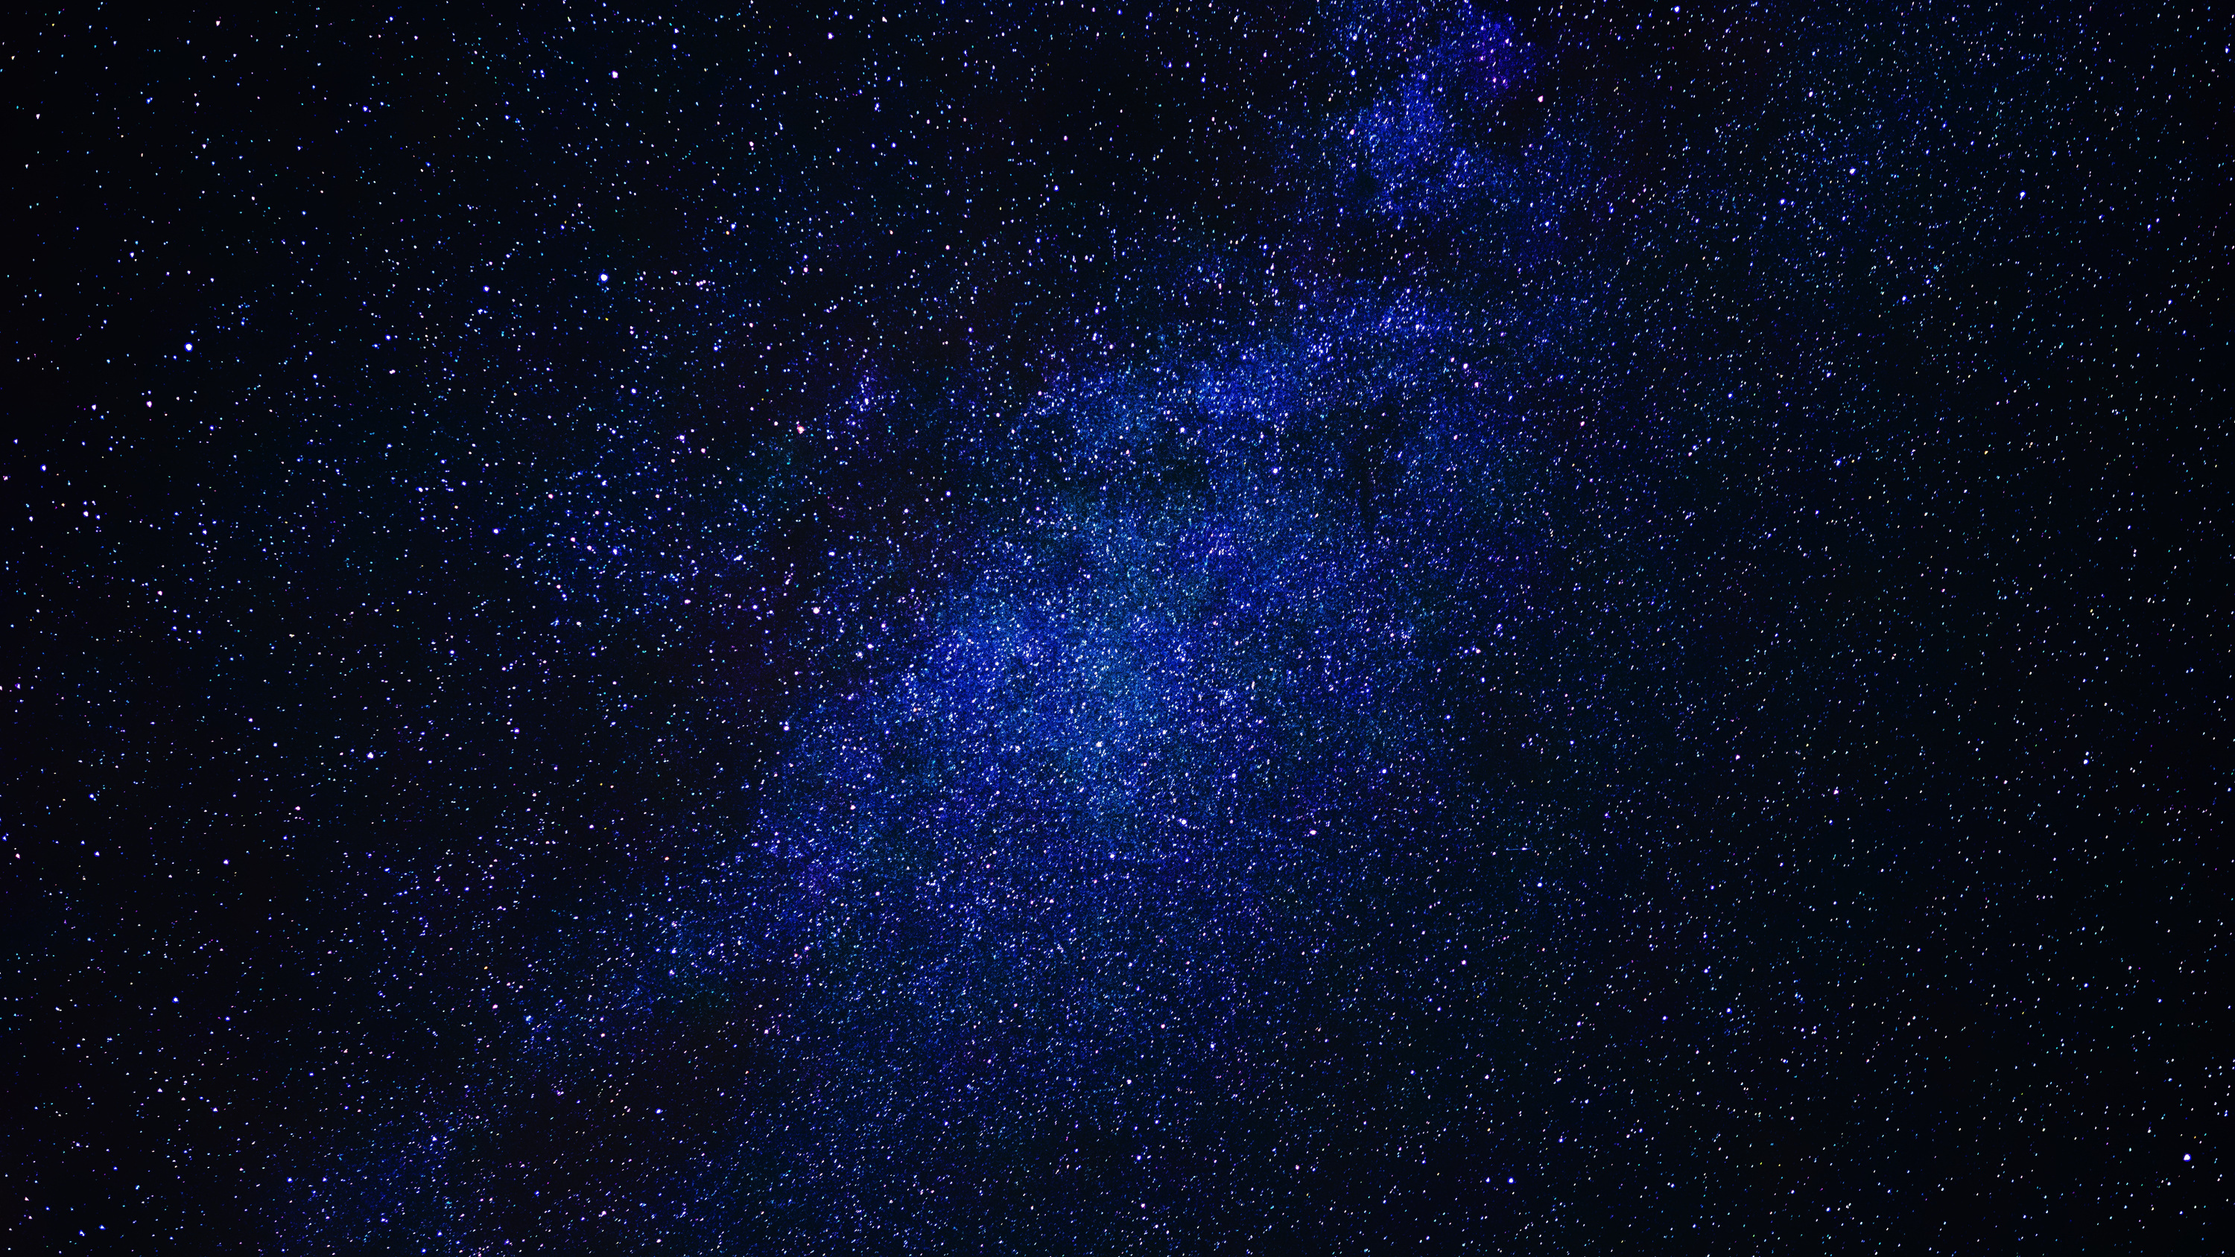
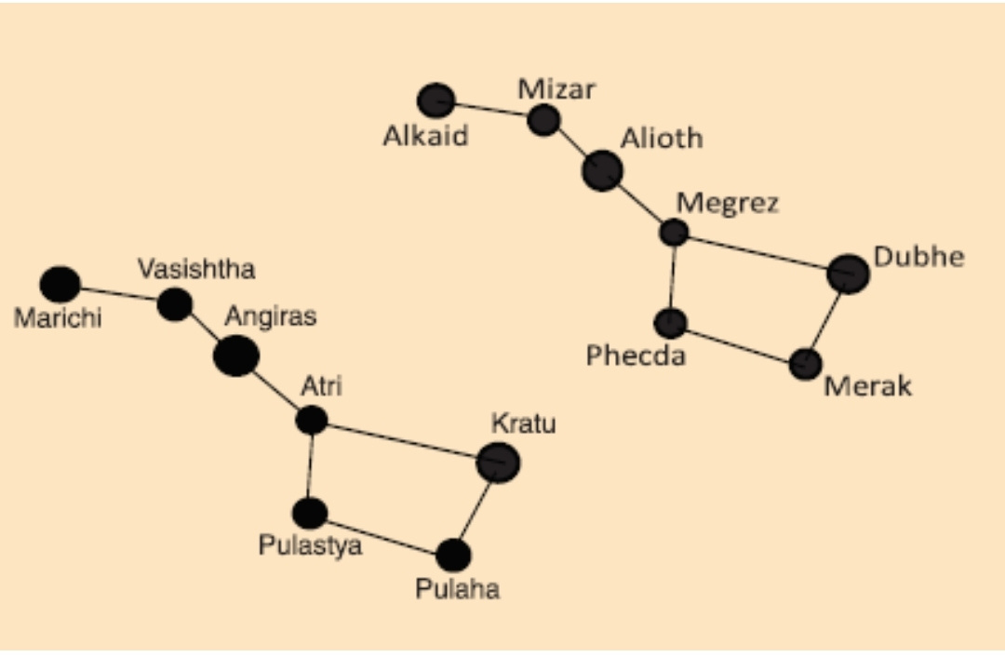

Slide 9
Activity 17.6
Observe this constellation for a few hours. Do you find any change in its shape? Do you find any change in its position? You will observe that the shapes of the constellation remain the same. You will also find that the constellation appears to move in the sky from east to west.

Slide 10
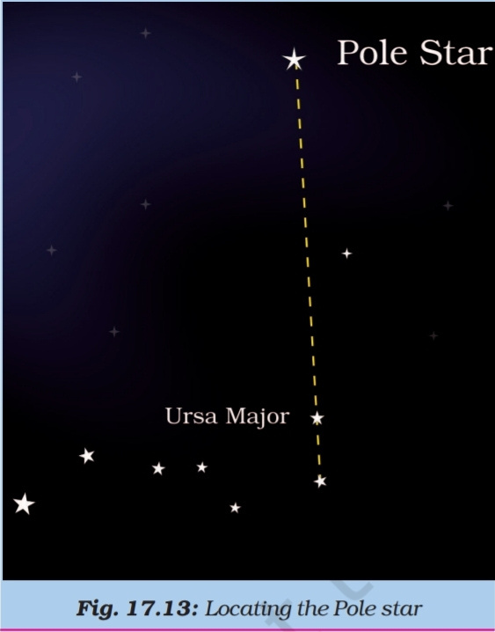
Activity 17.7
This activity should be performed on a clear moonless night during summer at about 9.00 pm. Look towards the northern part of the sky and identify Ursa Major. You may get help from elders in your family. Look at the two stars at the end of Ursa Major. Imagine a straight line passing through these stars as shown in Figure. Extend this imaginary line towards the north direction. (About five times the distance between the two stars.) This line will lead to a star which is not too bright. This is the Pole star. Observe the Pole star for some time. Note that it does not move at all as other stars drift from east to west.

Slide 11
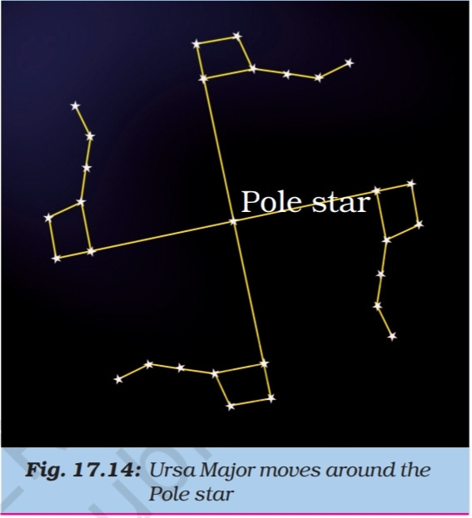
Activity 17.8
During a summer night, observe Ursa Major 3-4 times at an interval of 2 to 3 hours. Also locate the Pole star each time. Does Ursa Major appear to move from east to west? Does it appear to revolve around the Pole star? Compare your observations with those in Figure.

Slide 12
Orion
All the stars appear to revolve around the Pole star. The Pole star is not visible from the southern hemisphere. Some of the northern constellations like Ursa Major may also not be visible from some points in the southern hemisphere. Orion is another well-known constellation that can be seen during winter in the late evenings. It is one of the most magnificent constellations in the sky. It also has seven or eight bright stars [Figure 1] Orion is also called the Hunter. The three middle stars represent the belt of the hunter. The four bright stars appear to be arranged in the form of a quadrilateral.
The star Sirius, which is the brightest star in the sky, is located close to Orion. To locate Sirius, imagine a straight line passing through the three middle stars of Orion. Look along this line towards the east. This line will lead you to a very bright star. It is Sirius. (Figure 2).

Slide 13
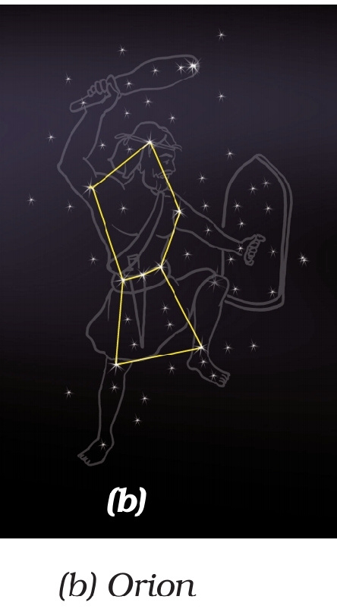
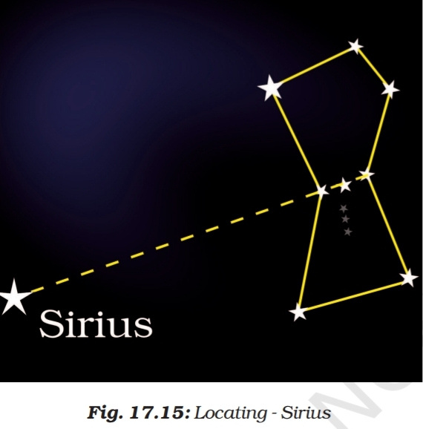

Slide 14
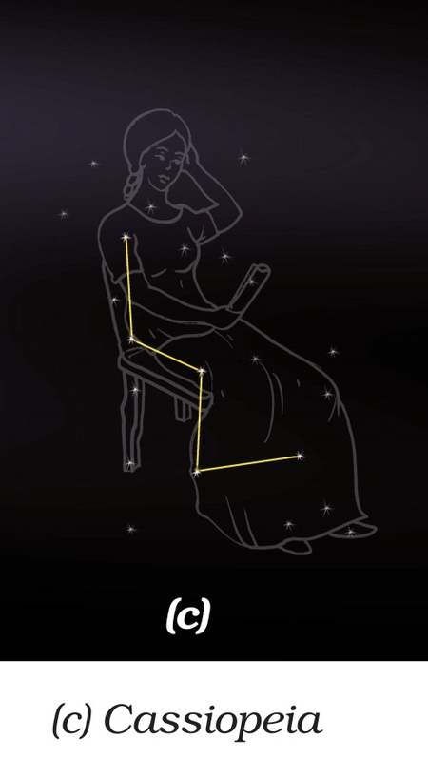
Cassiopeia
Cassiopeia is another prominent constellation in the northern sky. It is visible during winter in the early part of the night. It looks like a distorted letter W or M [Figure].

Slide 15
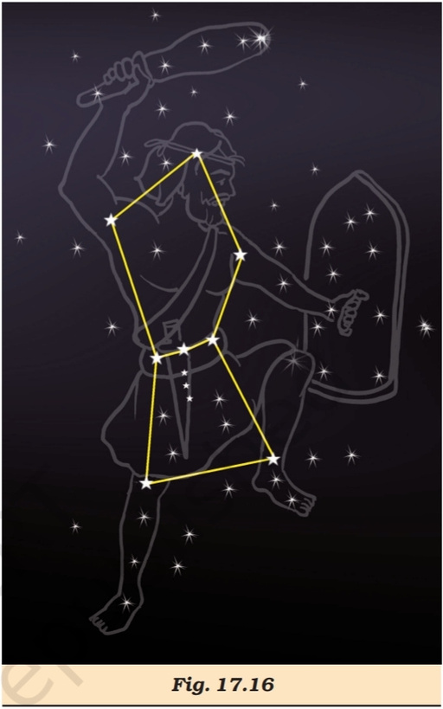
A constellation does not have only 5-10 stars. It has a large number of stars (Figure). However, we can see only the bright stars in a constellation with our naked eye. All the stars which make up a constellation are not at the same distance. They are just in the same line of sight in the sky.

Slide 16
Thank you very much!

